Slide 1
Hessian Accumulation Changes

Slide 2
Traj-Phase Level Flagging
 | Current | Suggestion
Flags | recomputeUserFunctions recomputeQuadratures recomputeAlgPathConstraints recomputeAlgCostFunction | isNewDecVec
Remark | Complicated Compute things when getting Now there is a bug on cost | Compute all things when setting decision vector Only check decVec is new or not The order of get-methods does not matter
Result = GetCostFunction()/GetConstraintVector()
CheckFunctions()
Result=ComputeFunc/Jac/Hess(decVec)
SetDecisionVector()
Return GetFunc/Jac/Hess
Compute All
Return cost/constraintVector
If isNewDecVec == true
Else; Do nothing
Compute cost/constraintVector
Check, is new decVec?
Now Vs. Suggestion

Slide 3
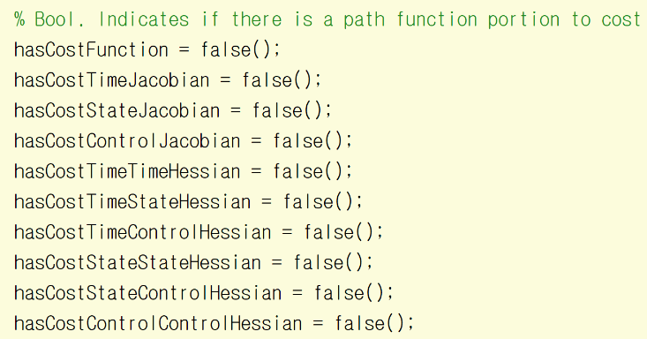
UserPathFunction Level
Booleans of user-function
=> Suggestion can be also applied to sparsity patterns
Suggestion
Extrapolating the current
#include <boost/numeric/ublas/symmetric.hpp>
enum FunctionType { DYNAMICS, COST, ALGEBRAIC };
enum JacobianType { STATE, CONTROL, TIME };
Vector<bool> hasFunction
// ex. hasFunction(funcType)
matrix<bool> hasJacobian
// ex. hasJacobian(funcType, jacType)
std::vector<symmetric_matrix<bool, lower>> hasHessian
// ex. hasHessian[funcType](jacType, jacType)

Slide 4
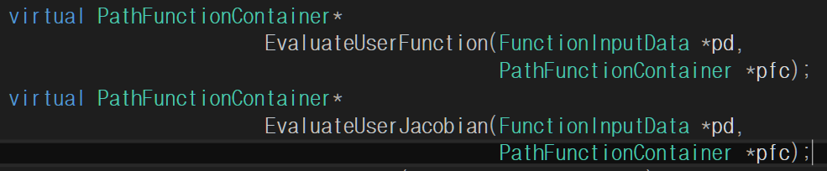
User Function Level
Current evaluation process of user-function
But there are limitations when computing Hessian
For efficient Hessian evaluation, suggestion:
Jacobian and Hessian sparsity patterns indicating => funcType by funcType evaluation must be done
Not providing user-jac/hess will not be problem just as now.
Maybe only the hardcore users provide hessian-tensor.
Rvector funcVec = EvaluateUserFunction(*pd, *pfc, funcType)
Rmatrix jacMat = EvaluateUserJacobian(*pd, *pfc, funcType, jacType)
std::vector<Rmatrix> hessTensor =
EvaluateUserHessian(*pd, *pfc, funcType, jacType1, jacType2)

Slide 5
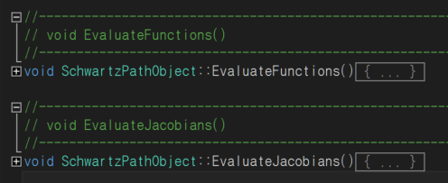
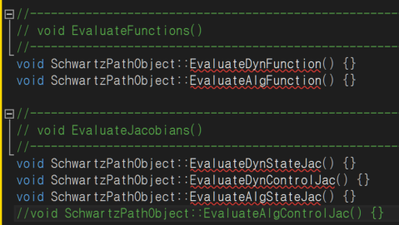
User Function Level
Current user-methods
of user-function
For efficient Hessian evaluation, suggestion:
A more number of user-defined methods are required
Not providing user-jac/hess will not be problem just as now.
Function Manager(or, new Derivative Manager) will handle undefined derivatives

Slide 6
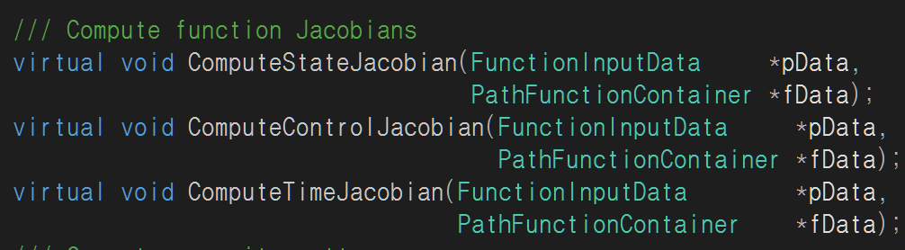
User Function Manager Level
Current derivative evaluation process of user-function manager
But there are limitations when computing Hessian
For efficient Hessian evaluation
With given user jac and hess, computing function, jacobian, and hessian altogether can reduce computation burden, significantly
Jacobian and Hessian sparsity patterns indicating => funcType-by-funcType evaluation must be done:
Apply the same method for all function types
void ComputeAll(FunctionInputData *pData,
PathFunctionContainer *fData,
FunctionType type, bool isComputingHess = false)

Slide 7
Disscussion
For efficient Hessian evaluation, suggestion:
Pros:
Support hessian computation (more reliable results for difficult problems)
Fast speed with hessian computation
Better programming structure (can remove redundant/repeated codes)
Cons:
Complicated user-function settings with a more number of methods
However:
Currently, there are only three function types, and only they are necessary
Not providing user-jac/hess will not be problem just as now
Maybe only the hardcore users provide hessian tensor
Therefore, the entry-level users only need to set three methods (all functions) to run CSALT (in the future, maybe five)
Adding a derivative checker to CSALT can make things easier for the users than now
I guess that the suggested changes will make the user-interface more complicated but the benefits from performance improvements (in terms of speed for adv. users and general convergence) seems to be greater than drawbacks

